Slide 1
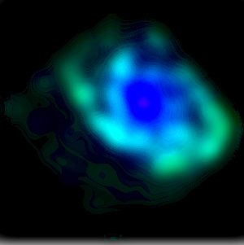
円盤でのクランプ形成とその進化
野口正史 （東北大学）

Slide 2
Numerical simulation
Disk galaxy evolution driven by
massive clumps
Analytical model
building Hubble sequence

Slide 3
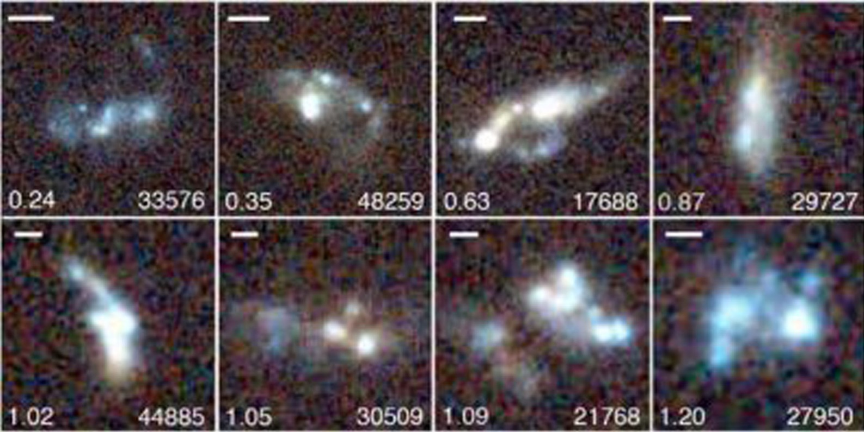

Clumpy Galaxies
${10}^{10−11}M_{⨀}$ galaxies at $z\sim 1−3$
(Elmegreen & Elmegreen 2005, ApJ, 627, 632; Genzel et al. 2011, ApJ, 733, 101)

Slide 4
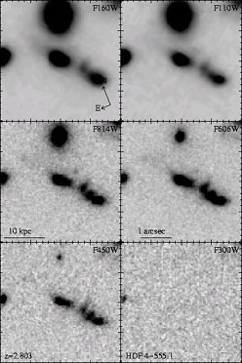
Chain Galaxies

Slide 5
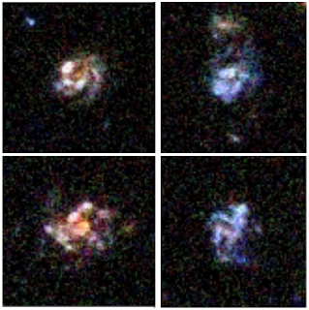



Clump characteristics
Size 1kpc
Mass ${10}^{8−9}$
several clumps
in a single galaxy
$$M_{⨀}$$
CANDELS $Z\sim 2$ galaxies

Slide 6
Numerical Simulation
Collapse of uniform, uniformly rotating gas in a rigid halo
Sticky particle method
Energy dissipation and star formation by inelastic collisions
Weak SN-feedback
(Noguchi, 1998, Nature, 392, 253)

Slide 7
Summary of Simulation
⩗ Massive clumps are formed by gravitational instability of early gas-rich galactic disks.
(size and mass of clumps consistent with gravitational instability picture)
⩗ Clumps are site of active star formation, leading to clumpy optical morphology of young disk galaxies.
⩗ Clumps, while merging with each other, spiral into central regions due to dynamical friction, possibly making galactic bulges.

Slide 8

Observed radial trend
consistent with migration scenario
with $τ\sim 0.5 Gyr$
(Guo et al. 2012, ApJ, 757,120)

Slide 9
What determines Hubble Type?
Many numerical studies followed
Immeli et al. 2004, ApJ, 611, 20
Bournard et al. 2007, ApJ, 670, 237
Aumer et al. 2010, ApJ, 719, 1230
Hopkins et al. 2012, MN, 427, 98
Bournard et al. 2013,
Inoue & Saitoh, 2011, MN, 418, 2527
……
but
Clump evolution model = bulge formation model

Slide 10
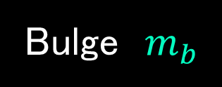



One-Zone Toy Model
(Noguchi, 1999, ApJ, 514, 77)
accretion
total mass $M$
size $R$
$(R\sim R_{25}$)
Bulge $m_{b}$
Disk $m_{g}$ $m_{s}$
Star Formation
$$ρ≡M/R^{3}$$
Clump-induced
inflow

Slide 11



Gas Accretion
$${\dot{m}}_{g}∝exp⁡\left(−t/β\right)$$
(mass fraction 𝚪)
Star Formation
$$SFR=αΣ_{g}^{N} R^{2}$$
$Σ_{g}$ $≡ m_{g}$/(${πR}^{2}$)
Clump-induced Inflow
Clump mass $Q=1$(Toomre’s criterion)
Dynamical friction timescale empirically determined from numerical simulation
$$\frac{τ_{fri}}{τ_{dyn}}=0.25 {\left(\frac{m_{cl}}{M}\right)}^{−0.5}{\left(\frac{Σ}{M/R^{2}}\right)}^{−0.67}$$

Slide 12


One-Zone Toy Model
(Noguchi, 1999, ApJ, 514, 77)
Basic equations
$\frac{dm_{g}}{dt}$ ＝－SFR -$\frac{m_{g}}{{ τ}_{fri}}+\frac{MΓt}{β^{2}} \text{exp}\text{(}−\frac{t}{β})$
$\frac{{dm}_{s}}{dt}$＝ SFR
$\frac{{dm}_{b}}{dt}$＝ $\frac{m_{g}}{τ_{fri}}$
accretion
Clump-induced
inflow
$$β Γ$$

Slide 13
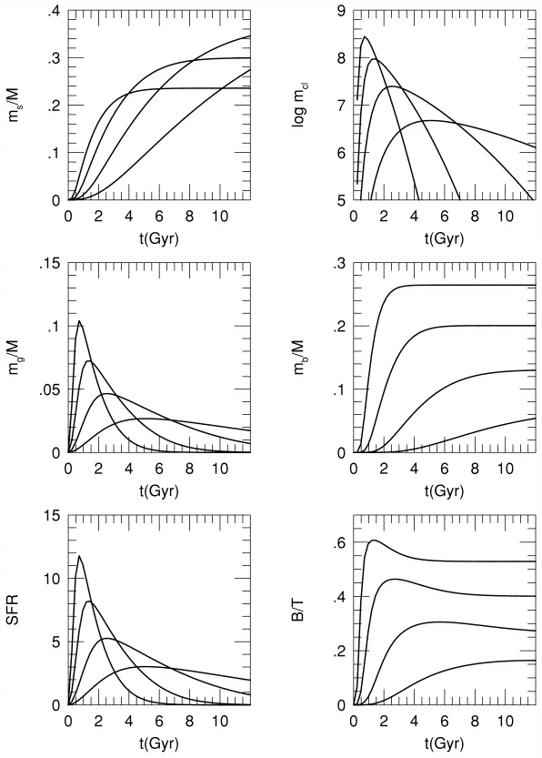
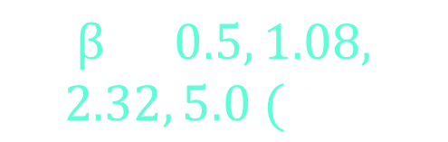




$β− Sequence$
Stellar Disk
Clump Mass
$$β=0.5, 1.08,$$
$$2.32, 5.0 (Gyr)$$
Gas Disk
Bulge
$$M={10}^{11}M_{⨀}$$
$$R=10 kpc$$
$$Γ=0.5$$
SFR
B/T

Slide 14
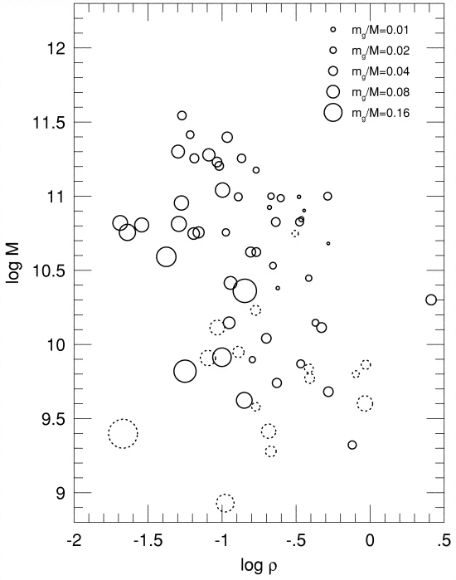


$$(β ,Γ)$$
$$(M ,ρ)$$
Gas mass fraction
observation
Increasing 𝜷
Gyr
Increasing Gas
Gyr
Gyr
Gyr
Gyr
Sage, 1993, A&A, 272, 123

Slide 15
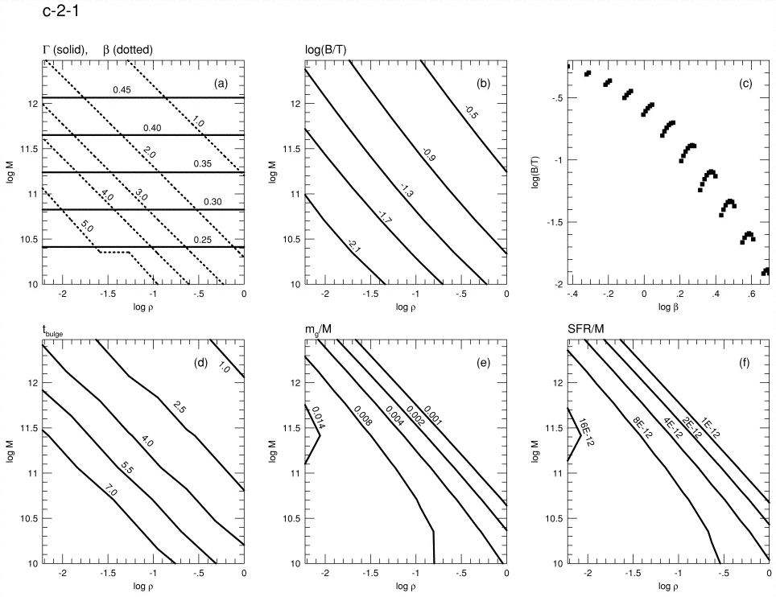
Model Results
t=12 Gyr
Gyr
Gyr
Gyr
Gyr
Gyr

Slide 16
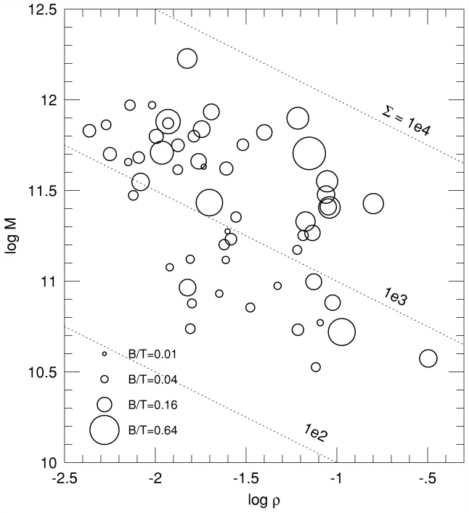

B/T$≡ m_{b}/(m_{s}$+$m_{b})$
Increasing bulge fraction
observation
model
Increasing Bulge
Whitmore, 1984, ApJ, 278,61

Slide 17
Conclusions
Clump-driven galaxy evolution model
can explain
the dependence of global properties
(B/D, gas fraction, specific SFR)
on galaxy mass and density.
By relating (β, Г) to (M, ρ ) adequately
(May solve Tully-Fisher zero-point problem)

Slide 18

Understanding Hubble sequence
B/T
Large mass
high density
Large baryon fraction
Rapid accretion
Gas-rich disk
Massive clumps
Massive bulge
$$M$$
ρ
Г
β

Slide 19
Remaining Issues
“Clump longevity”
observation
▸ 200Myr-old stellar population
(Wuyts et al., 2012, ApJ, 753, 114)
▸ ubiquity of clumps among high-redshift galaxies
(Guo et al. 2012, ApJ, 757, 120)
Clumps seem long-lived
▸ strong outflows (Genzel et al. 2011, ApJ, 733, 101)
Quick dispersal

Slide 20

Remaining Issues
“Clump longevity”
model
results dependent on feedback recipe
▸ Quick (several×${10}^{7}$ yr) dispersal
(Hopkins et al. 2012, MN, 427, 968)
▸ Long-lived (several×${10}^{8}$yr) clumps
(Bournaud et al. 2013, Dekel & Krumholz, 2013, MN, 432, 455)
“Clumps lose mass by feedback but new accretion keeps clumps mass constant with time”

