Slide 1
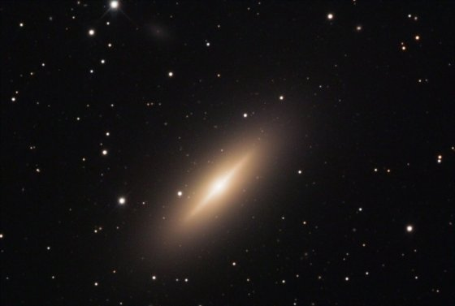
S0銀河形成と環境効果
円盤銀河形成研究会 (2013/9/27) @ 国立天文台三鷹
小山佑世 (国立天文台)
NGC3115 © NASA

Slide 2
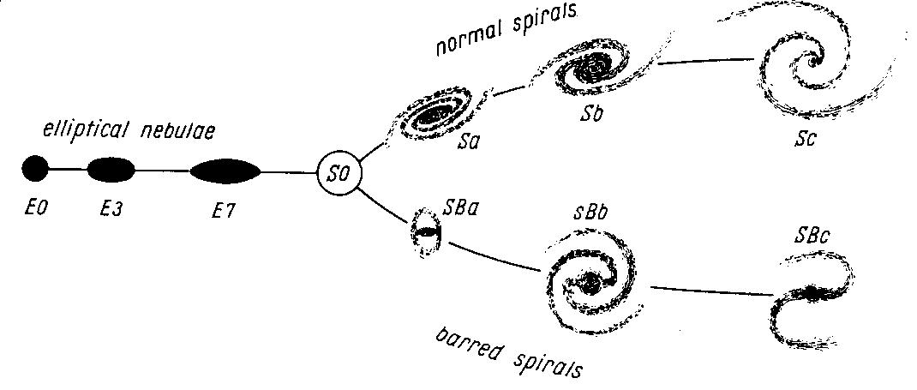
S0 (lenticular) galaxies
S0 galaxies are “intermediate” type between Es and Spirals.
Disk
Spheroid(passive)
S0 galaxies are:
- Disks without spiral arms.
(E. Hubble 1936)
- Bulge-rich (red colour)
- Gas poor (almost no SF)
- Dense environment

Slide 3
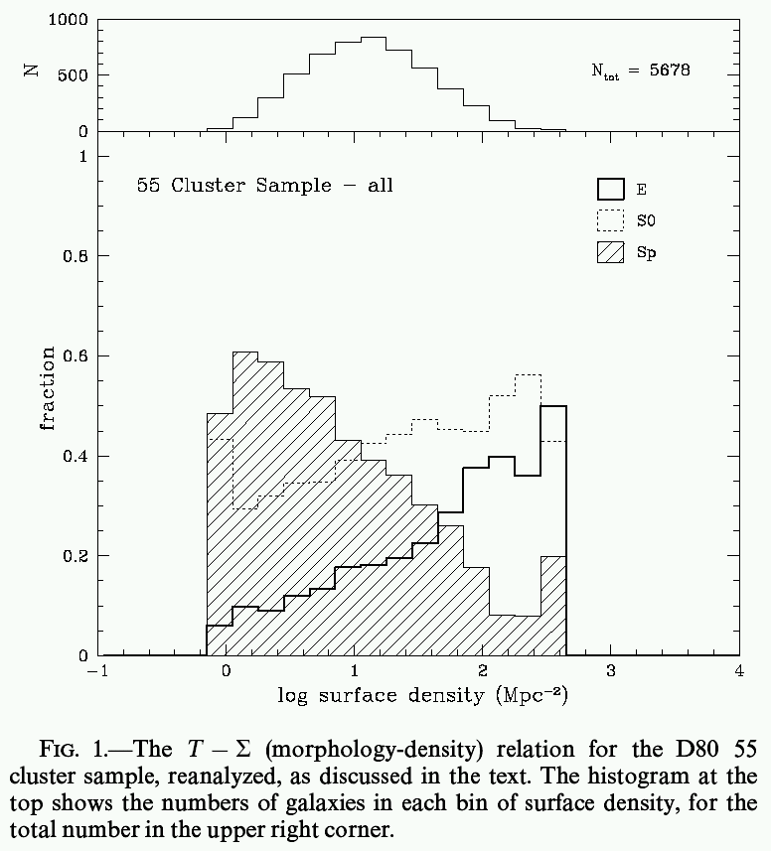
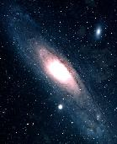
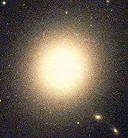
Environment of S0 galaxies (at z=0)
“ Morphology–Density Relation”
Spiral
red, old, low SF activity
E
S0
blue, young, high SF activity
Low-density
High-density
(Dressler 1980)
Notes:
3

Slide 4
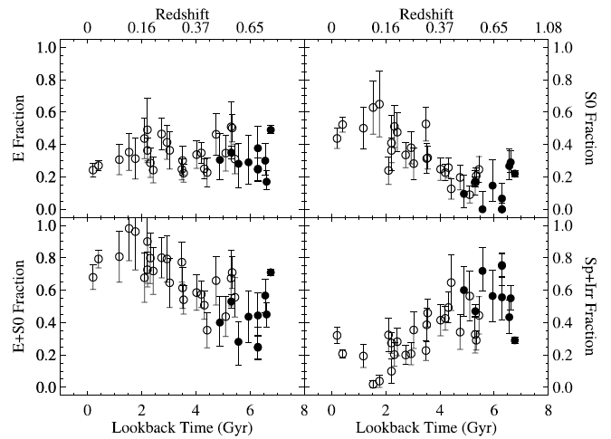
Morphological evolution in galaxy clusters
The most plausible explanation is spiral → S0 transformation.
E
S0
Sp+Irr
E+S0
(early-type)
(Desai et al. 2007)

Slide 5
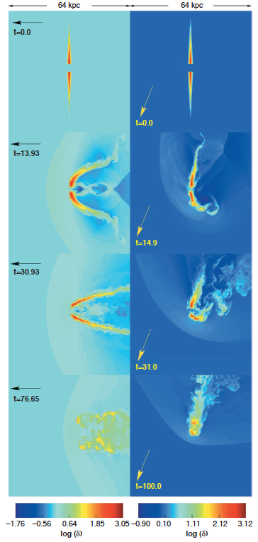
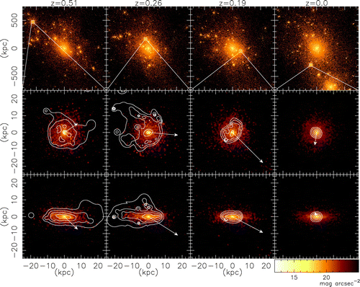
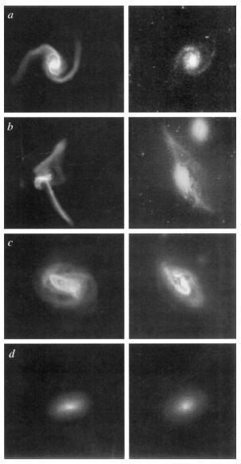
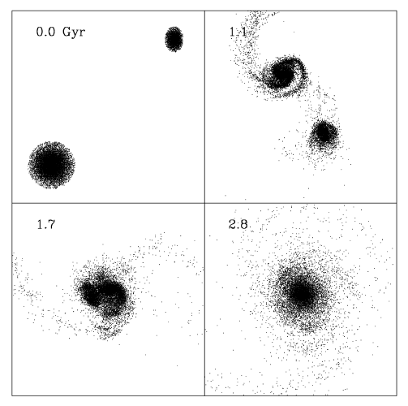
S0 galaxy formation process
Many proposed mechanisms can produce S0-like object…
Gas stripping
Halo gas stripping (strangulation)
(Moore+1996)
(Kawata+2008)
“Harassment”→
(multiple high-
speed encounter)
← Ram-pressure
stripping of
disk gas
(minor) merger →
(Quilis+2000)
(Bekki 1998)
Galaxy interaction

Slide 6
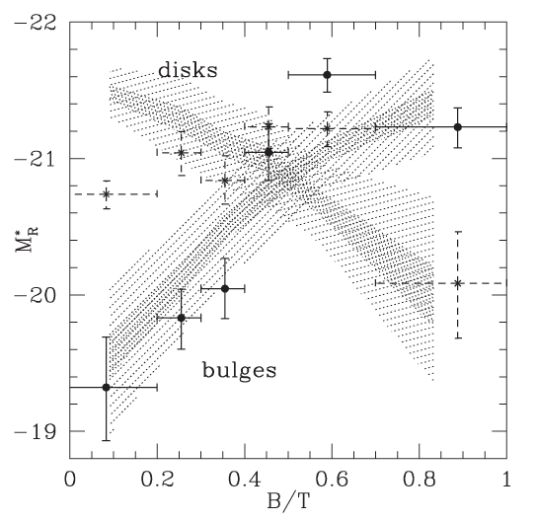
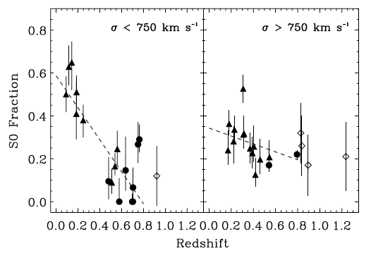
Requirement from observation
In order to increase B/T ratio:
◎ Bulge enhancement
△ Disk fading
Bulgeの光度
Late type
Early type
Poor groups
Rich groups
(Christlein & Zabludoff et al. 2004)
The site of S0 formation:
△ Rich clusters
◎ Poor groups
(Just et al. 2010)

Slide 7
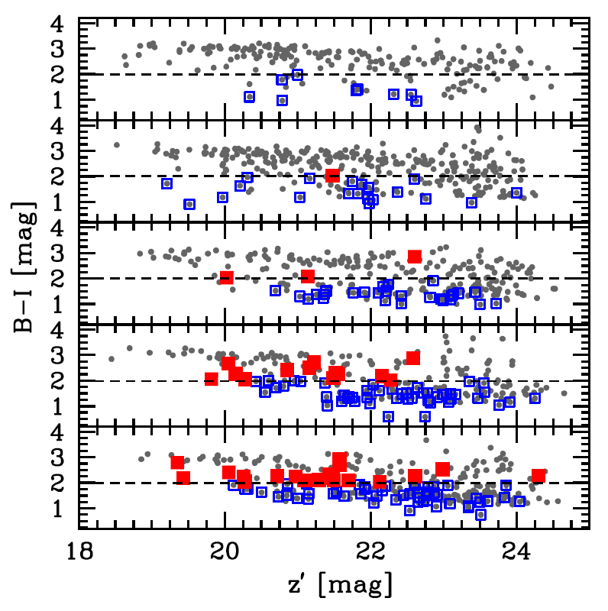
Dusty red galaxies in distant groups
Red Hα emitters are most prevalent in cluster surrounding groups.
(revealed by our S-Cam+NB921 survey of A851 cluster at z=0.4)
Rc<0.5 Mpc
0.5<Rc<1.0 Mpc
1.0<Rc<1.5 Mpc
West Clump
Groups
■:red Hα emitter (B-I>2)
(Koyama et al. 2011)
□:blue Hα emitter (B-I<2)

Slide 8
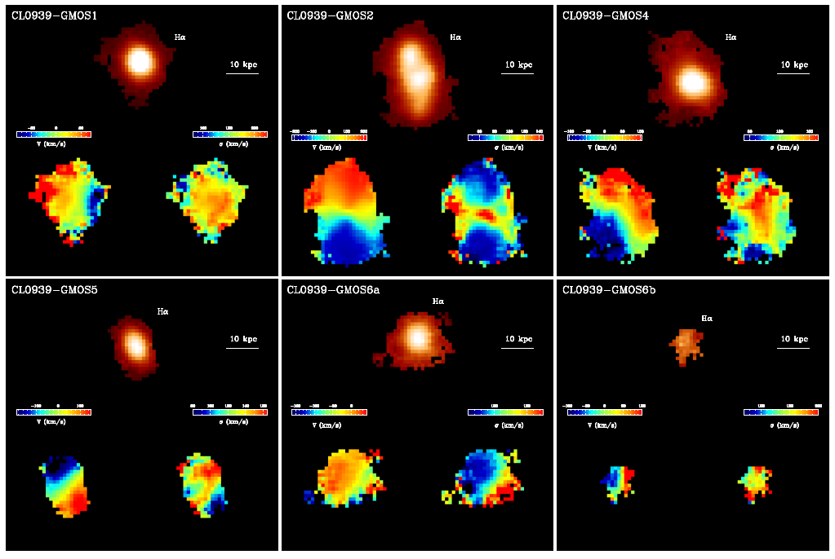
Dusty red galaxies: progenitors of local S0s?
Hα
V
σ
Our GMOS(N)+IFU obs. revealed their “disk” kinematics. (Koyama et al. in prep.)

Slide 9
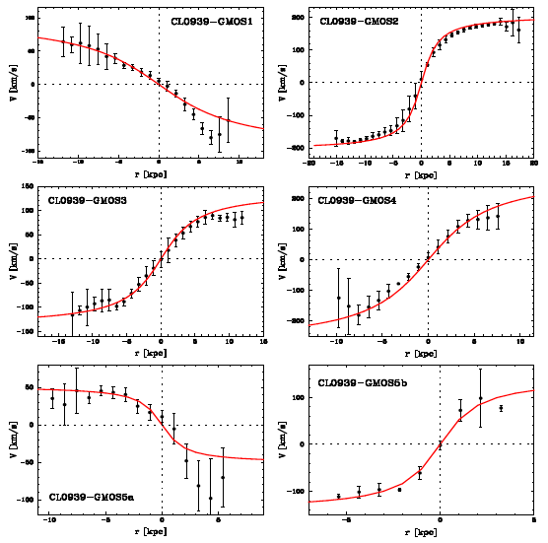
Dusty red galaxies: progenitors of local S0s?
Hα
V
σ
Our GMOS(N)+IFU obs. revealed their “disk” kinematics. (Koyama et al. in prep.)

Slide 10
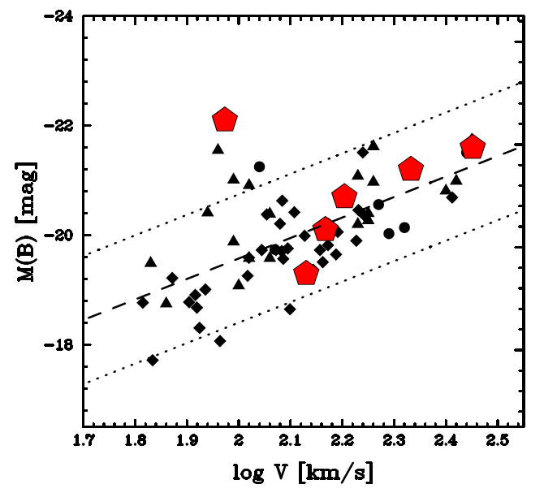
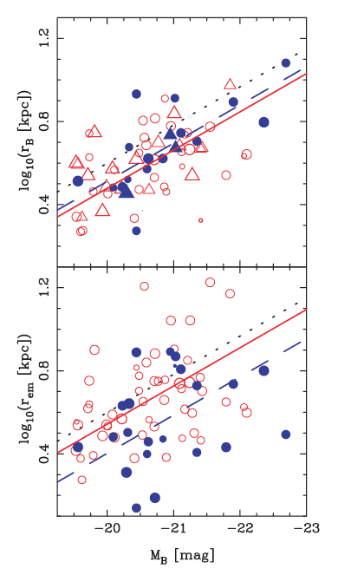
Tully-Fisher relation & size-luminosity relation
Good agreement with Tully-Fisher relation for z~0.4 field galaxies.
Black: field galaxies (0.3<z<0.5)
[Bamford+05/Nakamura+06/Miller+11]
: This study (IFU, z=0.4)
Preliminary
z=0.5 field
z=0.5 cluster
: This study
SF region in cluster galaxies tend to be more compact than field galaxies → evidence for S0 bulge growth?
(plot from Bamford et al. 2007)

Slide 11
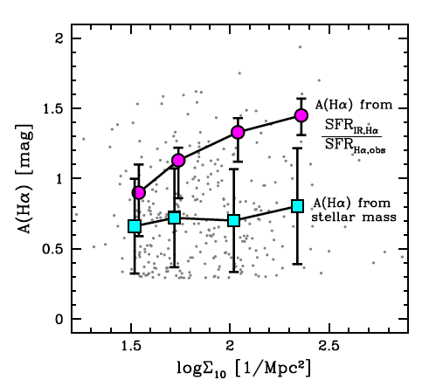
Dust extinction vs. environment
SF galaxies in clusters tend to be more highly obscured by dust?
A(Hα) from
SFR(IR)/SFR(Hα)
z=0.4 sample
(Hα emitters only)
A(Hα) from
A(Hα)-M* relation
(Koyama et al. 2013, MNRAS, 434, 423)

Slide 12
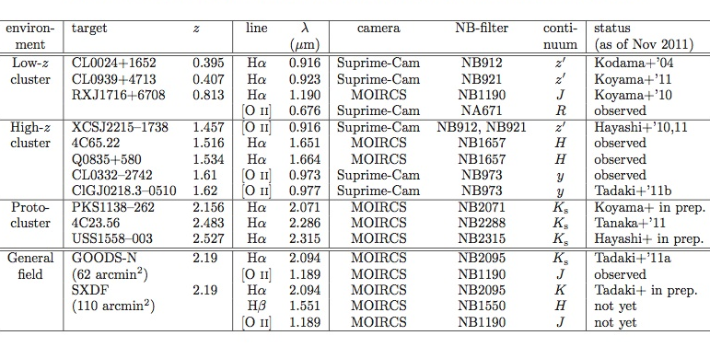
MAHALO-Subaru project
Collaborator: T.Kodama (PI), M.Hayashi, K.Tadaki, I.Tanaka, R.Shimakawa
MApping H-Alpha and Lines of Oxygen with Subaru
Narrow-band Hα/[OII] emission-line survey of distant universe at 0.4<z<2.6
Tadaki+’12
Koyama+’13a
Hayashi+’12

Slide 13
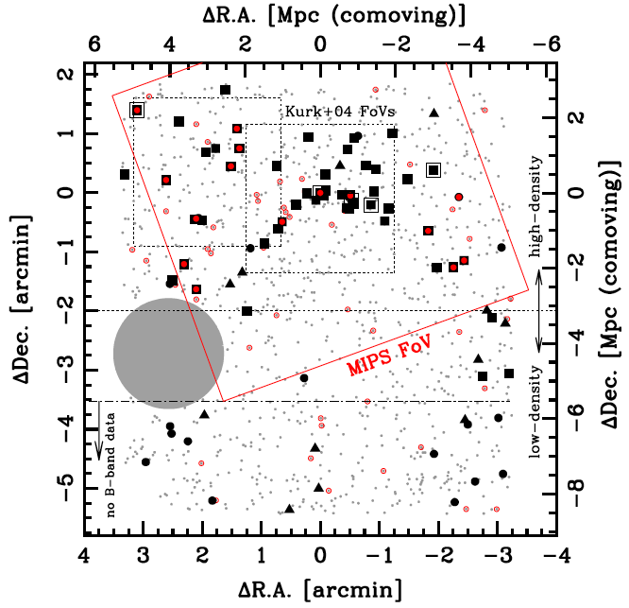
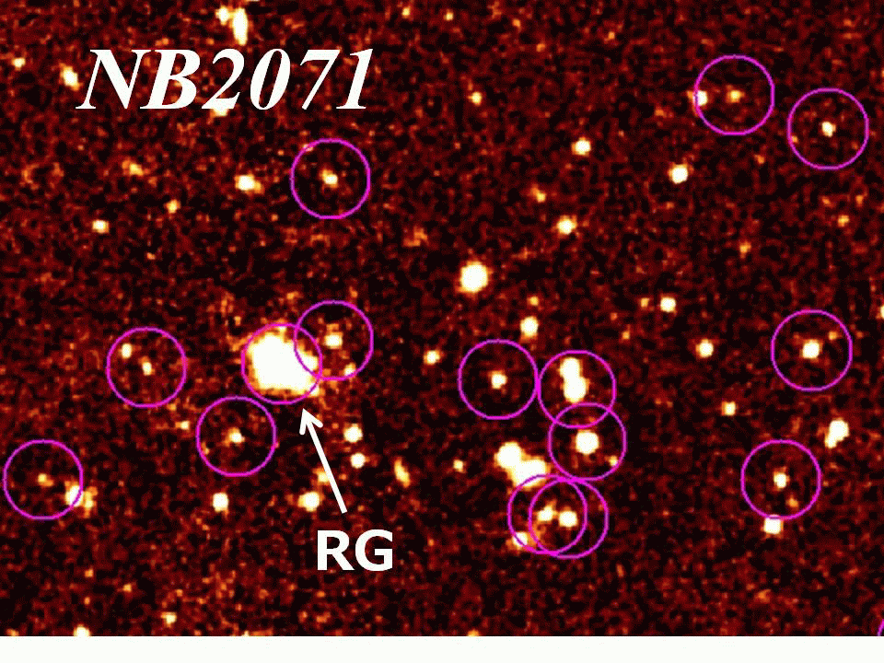
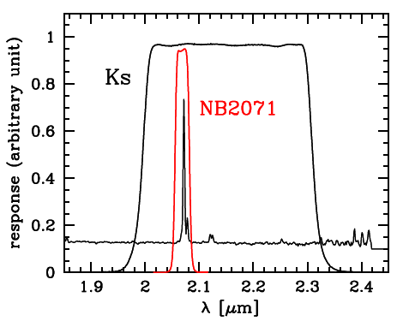
Hα imaging survey of a z=2.16 proto-cluster
Wide-field + NB imaging is an ideal tool for studying high-z clusters
PKS1138 @ z=2.16
Discovery of ~10Mpc filament at z=2.2 traced by HAEs
(MOIRCS)
Hα@z=2.16
(SFR_{Hα}>10M/yr)
▲■: HAEs @z=2.2
(Koyama et al. 2013a)
Notes:
13

Slide 14
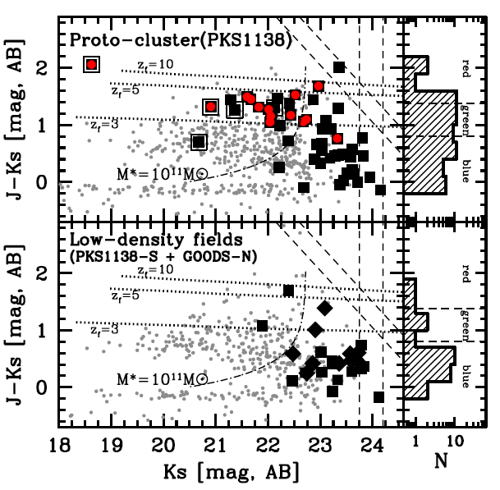
“Massive starbursts” in z>2 proto-cluster
SF galaxies in the proto-cluster tend to have redder colours & higher M* (>10¹¹M) compared to general field galaxies at the same redshifts.
: 24um-source
(Koyama et al. 2013a)
Notes:
14

Slide 15
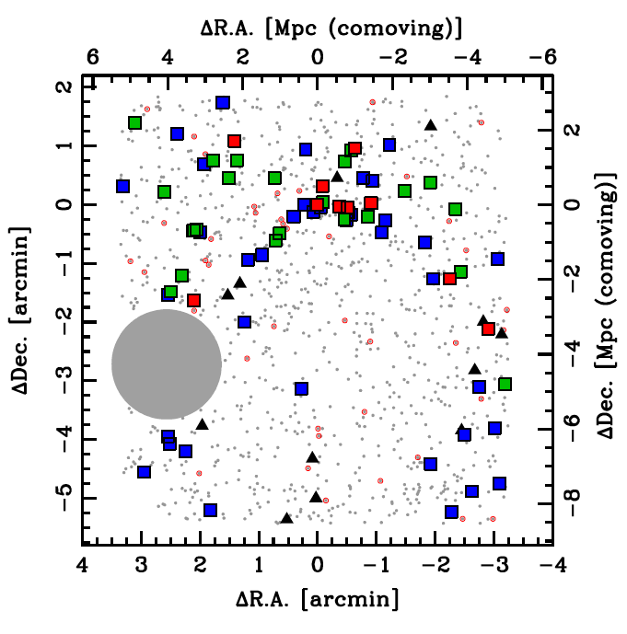
“Massive starbursts” in z>2 proto-cluster
SF galaxies in the proto-cluster tend to have redder colours & higher M* (>10¹¹M) compared to general field galaxies at the same redshifts.
: 24um-source
■： red HAE
(J-KAB>1.38, DRG)
■： green HAE
(0.8<J-KAB<1.38)
■： blue HAE
(J-KAB<0.8)
(Koyama et al. 2013a)
Notes:
15

Slide 16
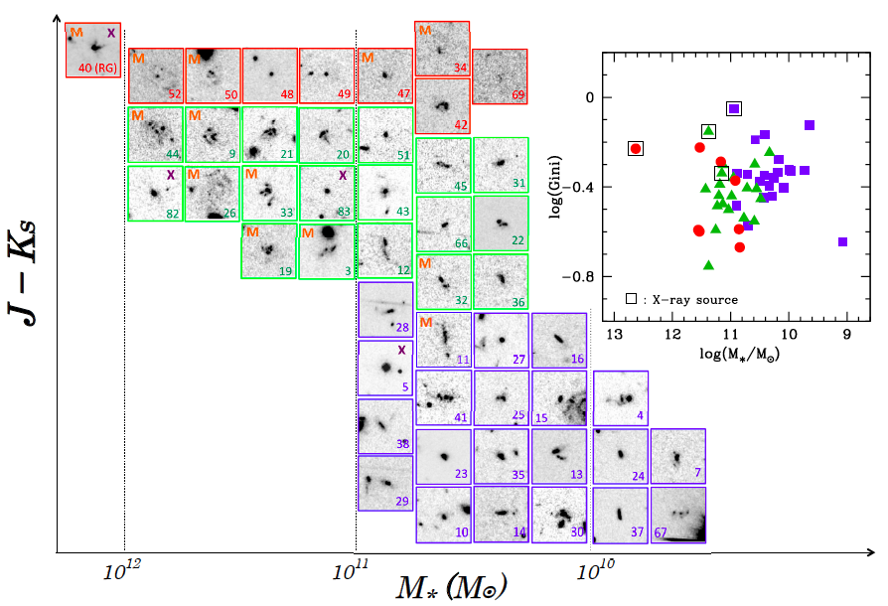
Rest-UV morphologies of proto-cluster galaxies
cluster phenomena !
z=2.2 HAEs
in PKS1138
M: 24um source
X: X-ray source
HST/i-band snapshots
(4”x4”=30 kpc for each)
(Koyama et al. 2013a)
Notes:
16

Slide 17
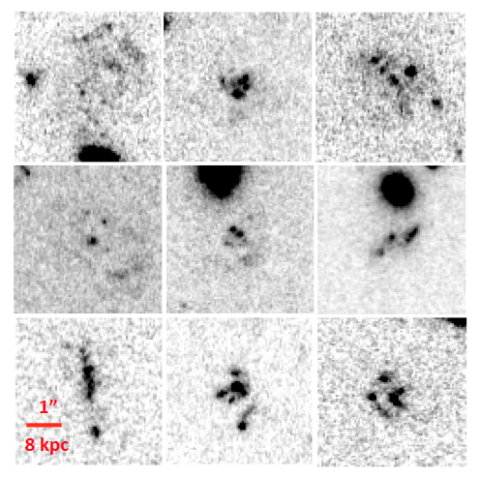
Rest-UV morphologies of proto-cluster galaxies
cluster phenomena !
z=2.2 HAEs
in PKS1138
M: 24um source
X: X-ray source
HST/i-band snapshots
(4”x4”=30 kpc for each)
(Koyama et al. 2013a)
Notes:
17

Slide 18
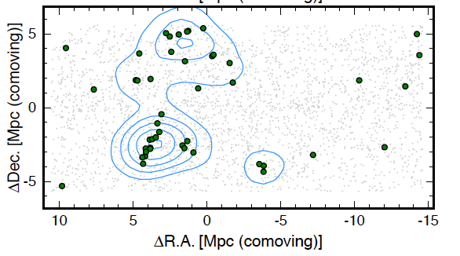
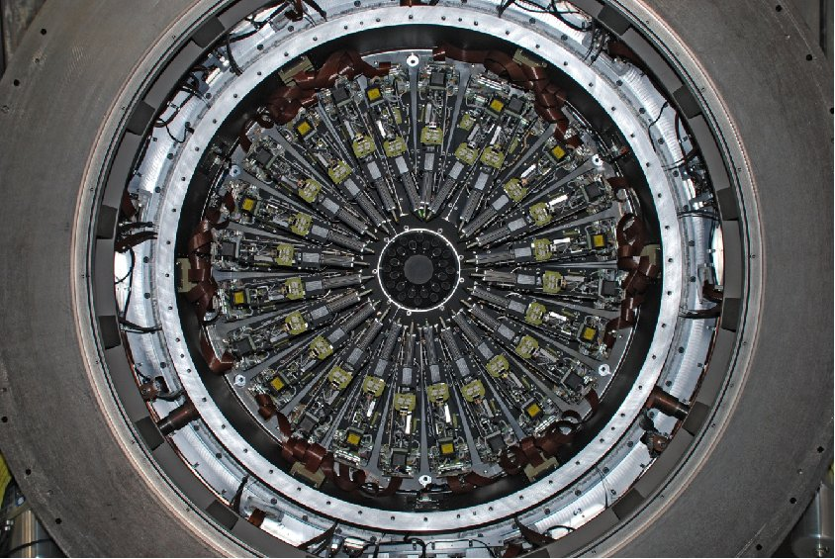
KMOS/VLT time approved (in 2013B semester)
Revealing kinematics of galaxies within Hα-selected proto-cluster (z=2.5)
KMOS/VLT
24 IFUs / 7’ FoV
KMOS FoV
2D distribution of Ηα emitters at z=2.53 in SXDF/CANDELS field
(with MOIRCS/NB2315 survey by Tadaki et al. 2013)

Slide 19
Summary
S0銀河の形成と環境効果には密接な関係。特にz<1の銀河群環境でS0銀河の形成がさかんに起こった。
(2) 遠方銀河団の周辺環境に多く見られる「赤い星形成銀河」
が近傍銀河団に見られるS0銀河の祖先である可能性あり。
→ IFU観測から「赤い星形成銀河」の円盤回転の証拠が得られた。
(3) z>2 の原始銀河団にはすでにM★~10¹¹Mを超えた大質量
星形成銀河(かつクランピー)が多数存在する。これは
同時代のフィールド銀河ではかなり珍しい種族である。
→ 初期宇宙での銀河環境効果を調べるためのベストサンプル。
(4) z=2.5の原始銀河団を狙ったKMOS/VLTの観測時間を獲得。
原始銀河団環境の銀河内部構造の解明に、乞うご期待。

