Slide 1
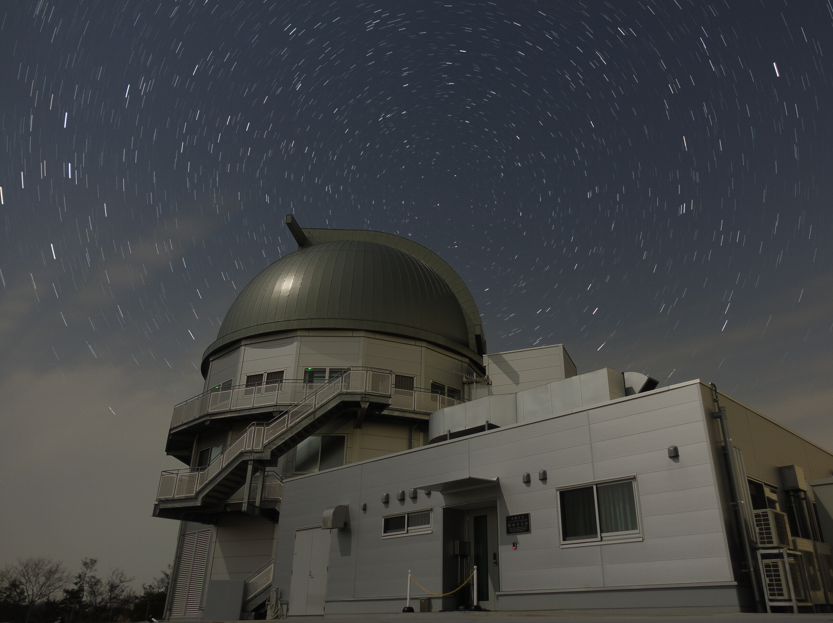
Introduction to Infrared Astronomy
-Brilliant Possibilities-
Tetsuya Nagata (Kyoto University)
Selamat pagi.
My research activities have included studies of interstellar medium, star formation, the center of Milky Way galaxy, and instrumentation. I have been the leader of the Kyoto Okayama 3.8-m telescope project. I am the president of the Japan Society of Infrared Sciences and Technology http://www.jsir.org/wp/
1. Introduction (History & Highlights)
2. Detection of Infrared Radiation
3. Observing through the Atmosphere
4. Background Emission
5. Interstellar Extinction
2019. 8. 19 Morning
Afternoon
2019. 8. 20 Morning
Afternoon
Okayama 3.8-m Telescope Dome taken by Ryo Tsukui (Kyoto U)

Slide 2
This short course covers the basics of infrared astronomy.
It is intended to help you to find information you may need in your research.
There will be 2 lectures per day for 2 days. Questions are encouraged, in and outside of class.
Largely based on the lectures in 2018
http://www.astron.s.u-Tokyo.ac.jp/students/news-for-graduate/
by Professor Alan Tokunaga (Univ Hawaii), who was my boss.
1. Introduction (History & Highlights) 2019. 8. 19 Moring
2. Detection of Infrared Radiation Afternoon
3. Observing through the Atmosphere
4. Background Emission 2019. 8. 20 Morning
5. Interstellar Extinction Afternoon
Introduction to Infrared Astronomy -Brilliant Possibilities-

Slide 3
These lectures provide a basic introduction to infrared (IR) astronomy. References are provided to allow the reader to pursue subjects in greater detail.
This work does not attempt to cover all aspects of IR astronomy;
it focuses on basic background information, observing techniques, instrumentation, and a specific science aspect of interstellar extinction.
I would like to put stress on orders-different effects, in IR observations in comparison with optical observations; at the risk of pointing out the glaring obvious, the value of exponential function changes enormously. We will see examples in the wavelength dependence of blackbody emission, and interstellar extinction.
They change like magic, and, in fact, I was fascinated by them and started studies of IR astronomy when I entered the graduate school.
Introduction to Infrared Astronomy -Brilliant Possibilities- 1. Introduction

